Slide 1

detecting toxicity on the Star Wars fandom on Twitter using machine learning
CS4014 - Applied Mathemathics
Miguel Cortés A01270966
Eider Díaz A00828174
Carlos Hinojosa A01137566

Slide 2
The problem
With the growth of the internet and social networks, people are continuously exchanging opinions. However, factors like anonymity and a lack of empathy have caused an unchecked freedom of speech which quickly turns into cyberbullying through hatespeech, mysoginy, racism and other forms of toxic interactions.
It’s crucial to keep a healthy environment on these online platforms. Studies relate social media screen time with increases in depressive sympthoms and suicide rates in the United States [1].
Due to the large amount of content published online every moment, is nearly imposible to keep social media platforms healthy by detecting and removing such content manually.
Can we use Machine Learning techniques to detect hate speech on social media?

Slide 3
Methodology
Collect Data
The dataset for building the model is publicy available at Crowdflower. It has also been used in [2] and [3].
This datset contains 25k tweets manually classified as ‘hateful’, ‘offensive’ and ‘clean’.
Data Preprocessing
Feature Extraction
Model Construction
Naïve Bayes
Logistic Regression
KNN
Experiments

Slide 4
techniques applied (Include Applied Math concepts you are using)
Tf-idf
is a numerical statistic that is intended to reflect how important a word is to a document in a collection or corpus.
The tf–idf value increases proportionally to the number of times a word appears in the document and is offset by the number of documents in the corpus that contain the word, which helps to adjust for the fact that some words appear more frequently in general

Slide 5
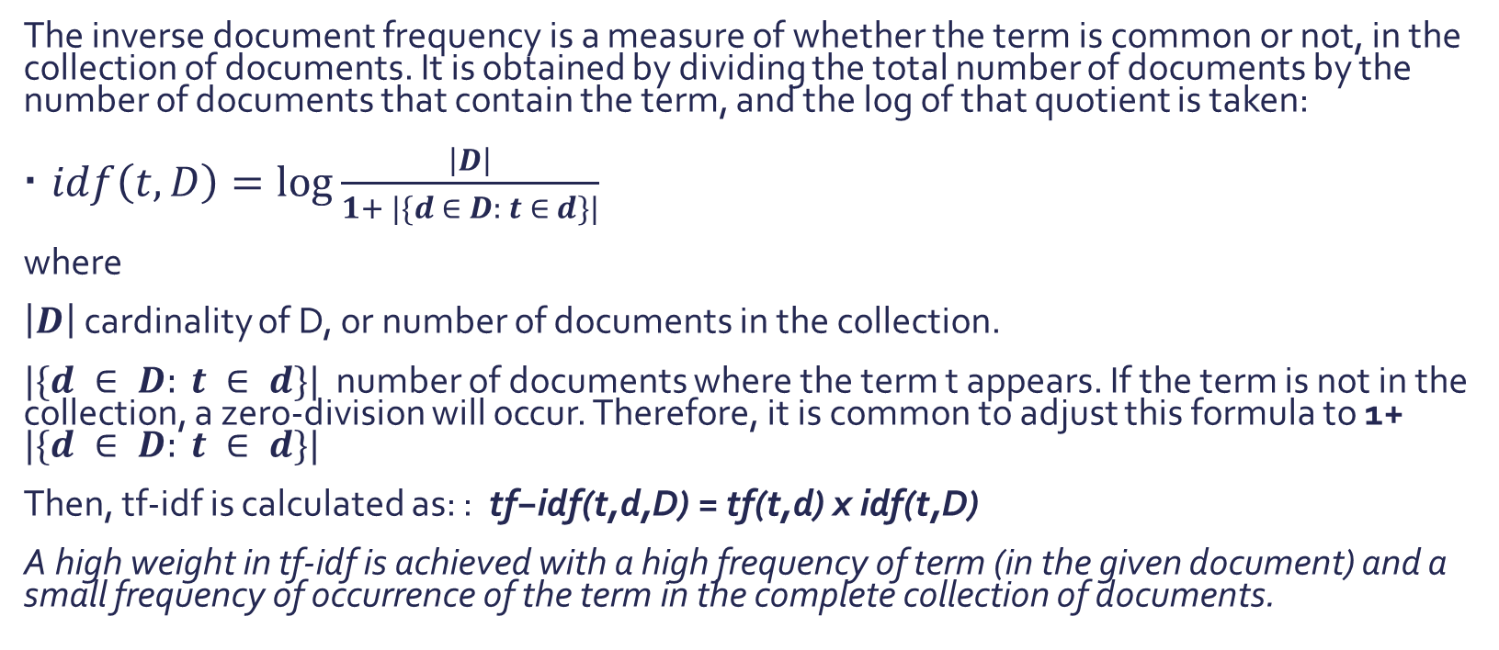
Tf-idf
The inverse document frequency is a measure of whether the term is common or not, in the collection of documents. It is obtained by dividing the total number of documents by the number of documents that contain the term, and the log of that quotient is taken:
$idf\left(t,D\right)=\log{\frac{\left|D\right|}{1+ |\{d ∈ D: t ∈ d\}|}}$
where
$\left|D\right|$ cardinality of D, or number of documents in the collection.
$|\{d ∈ D: t ∈ d\}|$ number of documents where the term t appears. If the term is not in the collection, a zero-division will occur. Therefore, it is common to adjust this formula to 1+ $|\{d ∈ D: t ∈ d\}|$
Then, tf-idf is calculated as: : $\text{tf}\text{−}\text{idf}\text{(}\text{t}\text{,}\text{d}\text{,}\text{D}\text{) = }\text{tf}\text{(}\text{t}\text{,}\text{d}\text{) }\text{x} \text{idf}\text{(}\text{t}\text{,}\text{D}\text{)}$
A high weight in tf-idf is achieved with a high frequency of term (in the given document) and a small frequency of occurrence of the term in the complete collection of documents.

Slide 6
Tf-idf
query
“The quick brown fox”
|D|=100
words
“The”
“quick”
“brown”
“fox”
tf
3000
1000
800
150
idf
Log
(100/101)
Log
(100/70)
Log
(100/70)
Log
(101/15)
tf-idf
12
154
123
165
Notes:
Suppose we have a collection of documents and we want to determine the most relevant document to the query “the quick brown fox". A simple way to start is to eliminate those documents that do not contain the three words "the", “quick“, “brown” and “fox", but there are still many documents. To differentiate them further, we must count the number of times each term occurs in each document and add them; The number of times a term occurs in a document is called its term frequency (tf).

Slide 7
n-gram
an n-gram is a contiguous sequence of n items from a given sample of text or speech.
We need to book our tickets soon > VERB
We need to read this book soon > NOUN
By using n-grams we capture the broader context of word to then train machines to Learn language ques and gain a better understanding of the real meaning of the text.
______
Notes:
an n-gram of size 1 is referred to as a "unigram"; size 2 is a "bigram" (or, less commonly, a "digram"); size 3 is a "trigram“

Slide 8
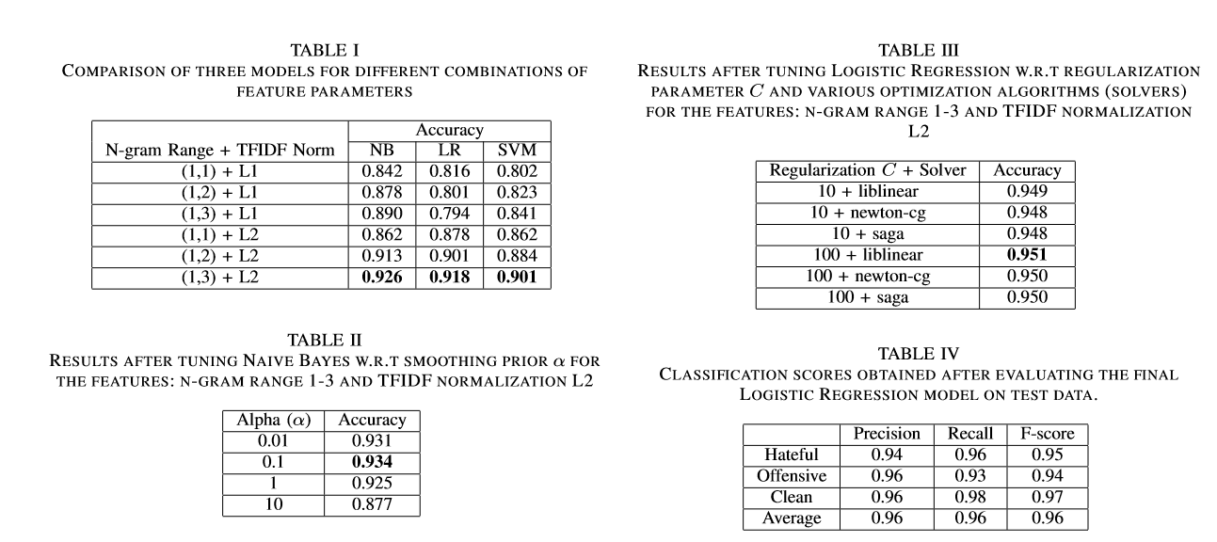
Results

Slide 9
Discussion

Slide 10
Conclusions and future work

Slide 11
references
[1] Twenge, J. M., Joiner, T. E., Rogers, M. L., & Martin, G. N. (2017). Increases in Depressive Symptoms, Suicide-Related Outcomes, and Suicide Rates Among U.S. Adolescents After 2010 and Links to Increased New Media Screen Time. Clinical Psychological Science, 6(1), 3–17. doi:10.1177/2167702617723376
[2] H. Watanabe, M. Bouazizi and T. Ohtsuki, “Hate Speech on Twitter: A Pragmatic Approach to Collect Hateful and Offensive Expressions and Perform Hate Speech Detection”, IEEE Access, vol. 6, pp. 13825-13835, 2018.
[3] T. Davidson, D. Warmsley, M. Macy and I. Weber, “Automated Hate Speech Detection and the Problem of Offensive Language”, in International AAAI Conference on Web and Social Media, 2017.

